Slide 1
Data Overview
Data:
ADR_USD = average daily rate
hotel_id
city_id
star_rating
accommodation_type
chain_hotel
Booking_date
checkin_date
checkout_date

Slide 2
Data Preparation
Combined data across 5 cities into one table in excel
Additional Features Introduced to capture data variation:
lead_time = checkin_date – booking_date
length_stay = checkout_date – checkin_date
arrival_month = month(checkin_date)
arrival_day = day(checkin_date)
arrival_week_number = weeknum(checkin_date)
booking_month = month(booking_date)
booking_day = day(booking_date)
booking_week_number = weeknum(booking_date)
Software: Excel, R Studio

Slide 3
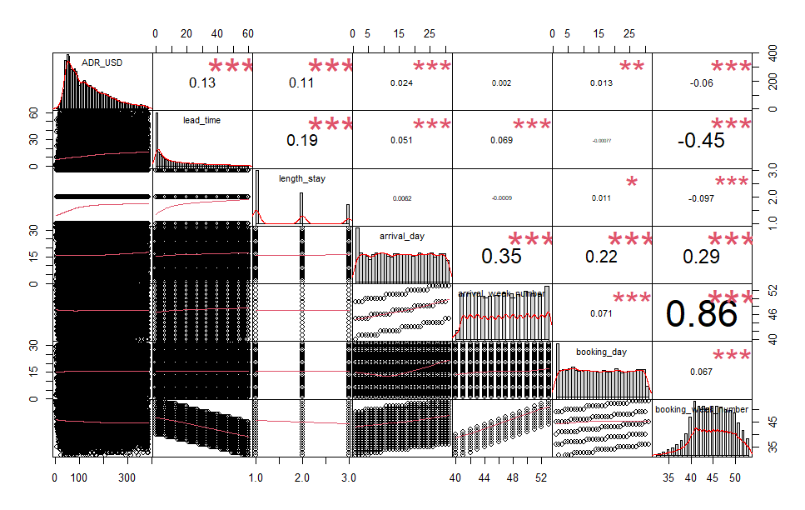
Correlation
Among the numeric inputs we have, ADR exhibits significant positive correlation to lead_time, length_stay, arrival_day.
We will explore the relationship between ADR and these numeric data, in addition to categorical data.

Slide 4
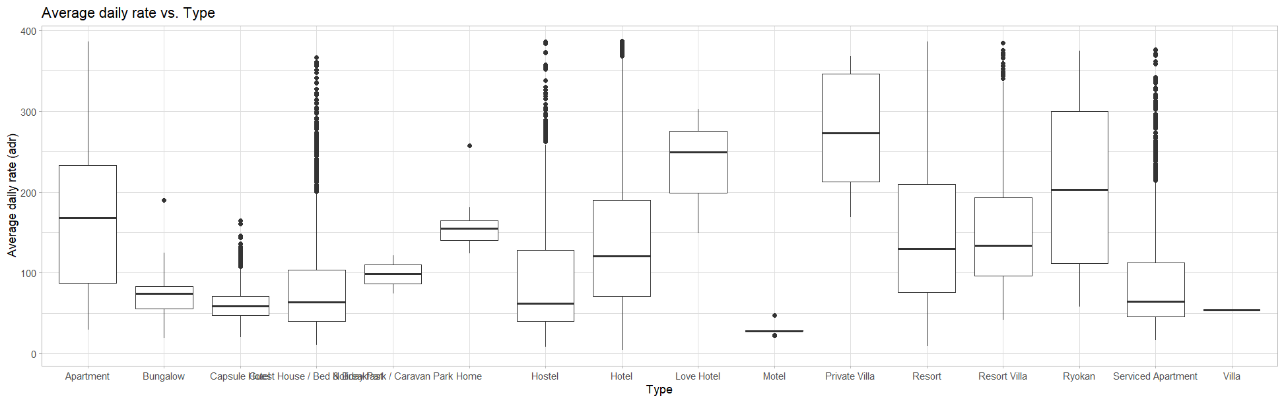
Data Analysis
Observation 3:
On average, private villa yields the highest ADR, with varying averages across different accommodation types.

